Slide 1
Can Revelation speak to our culture?
Revd Dr Ian Paul
www.psephizo.com

Slide 2
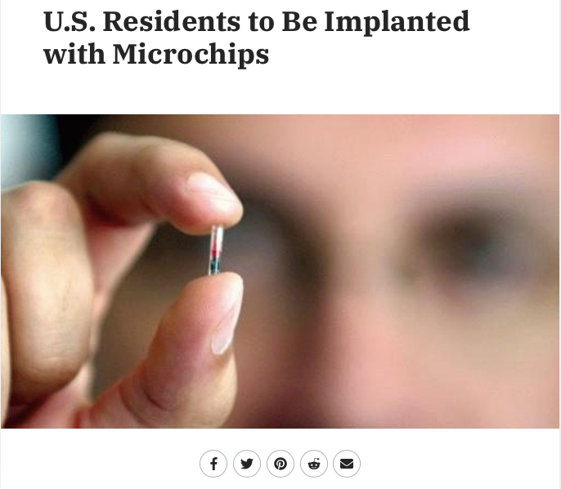

Slide 3
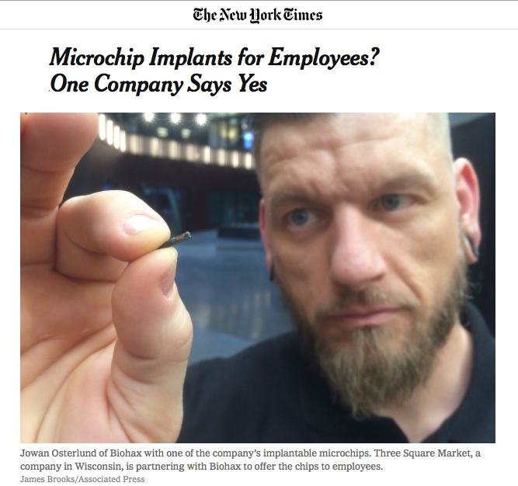

Slide 4
It also forced all people, great and small, rich and poor, free and slave, to receive a mark on their right hands or on their foreheads, so that they could not buy or sell unless they had the mark, which is the name of the beast or the number of its name. This calls for wisdom. Let those who have insight calculate the number of the beast, for it is the number of a man. That number is 666. (Rev 13.16–18)

Slide 5
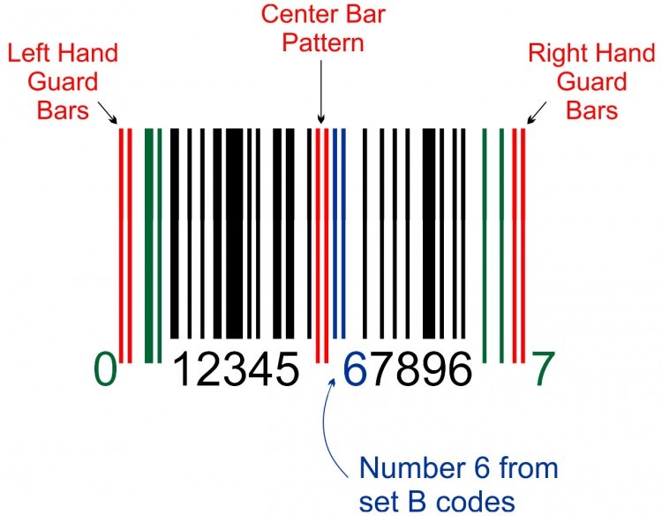

Slide 6
It also forced all people, great and small, rich and poor, free and slave, to receive a mark on their right hands or on their foreheads, so that they could not buy or sell unless they had the mark, which is the name of the beast or the number of its name. This calls for wisdom. Let those who have insight calculate the number of the beast, for it is the number of a man. That number is 666. (Rev 13.16–18)

Slide 7
Roland Barthes
writerly texts: the writer controls meaning
readerly texts: the reader creates meaning

Slide 8
1.1 The revelation of Jesus Christ (apocalyptic)
1.3 Blessed is the one (benediction)
1.4 John: to the seven churches (epistle)
1.5 To whom who loved us… (doxology)
1.7 Look, he is coming with the clouds (apocalyptic)
1.8 …thus says the Lord… (prophetic)
1.9 I, John, your brother (epistle)

Slide 9
The revelation from Jesus Christ, which God gave him to show his servants what must soon take place. He made it known by sending his angel to his servant John… (1.3)
I, Jesus, have sent my angel to give you this testimony for the churches (22.16)

Slide 10
As I watched, I heard an eagle that was flying in midair call out in a loud voice: “Woe! Woe! Woe to the inhabitants of the earth, because of the trumpet blasts about to be sounded by the other three angels!” (8.13)
The first woe is past; two other woes are yet to come. (9.12)
The second woe has passed; the third woe is coming soon. (11.14)

Slide 11
The one having ears…(to) the one conquering (Ephesus, Smyrna, Pergamum)
The one conquering…the one having ears (Thyatira, Sardis, Philadelphia, Laodicea)

Slide 12
John eats like a pig
John is a pig when it comes to eating
Here comes that pig again
The pig is coming to dinner

Slide 13
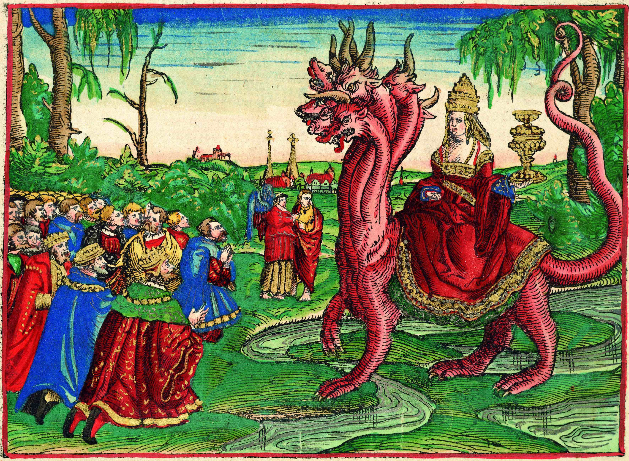

Slide 14
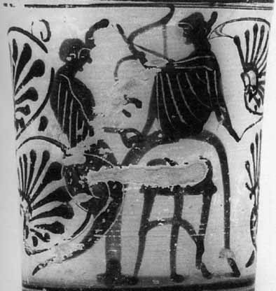
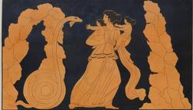
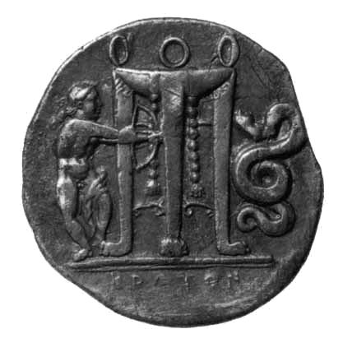

Slide 15
Connecting with today
‘666’
Roman
Imperial
power
Hitler, Rome, Europe, bar codes etc
Beastliness

Slide 16
1. Power and greatness
Myths of empire:
victorious, eternal, peaceful, wanted, beneficial

Slide 17
1. Power and greatness
2. Chaos and meaning
3. Economic exploitation and materialism
4. Environmental destruction

