Slide 2
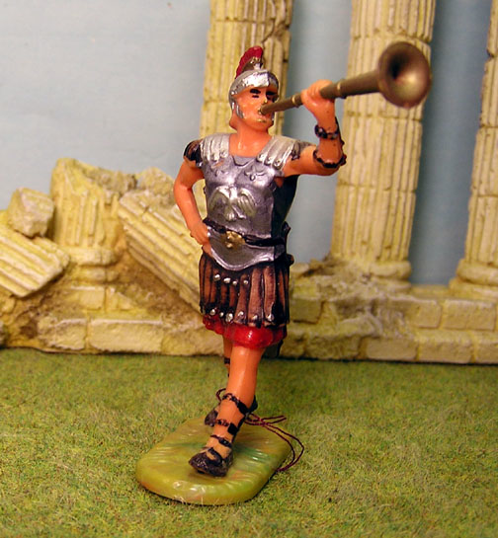

Slide 3
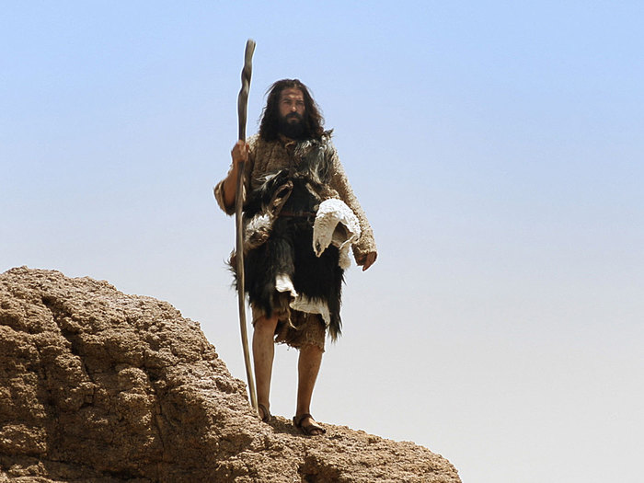

Slide 4
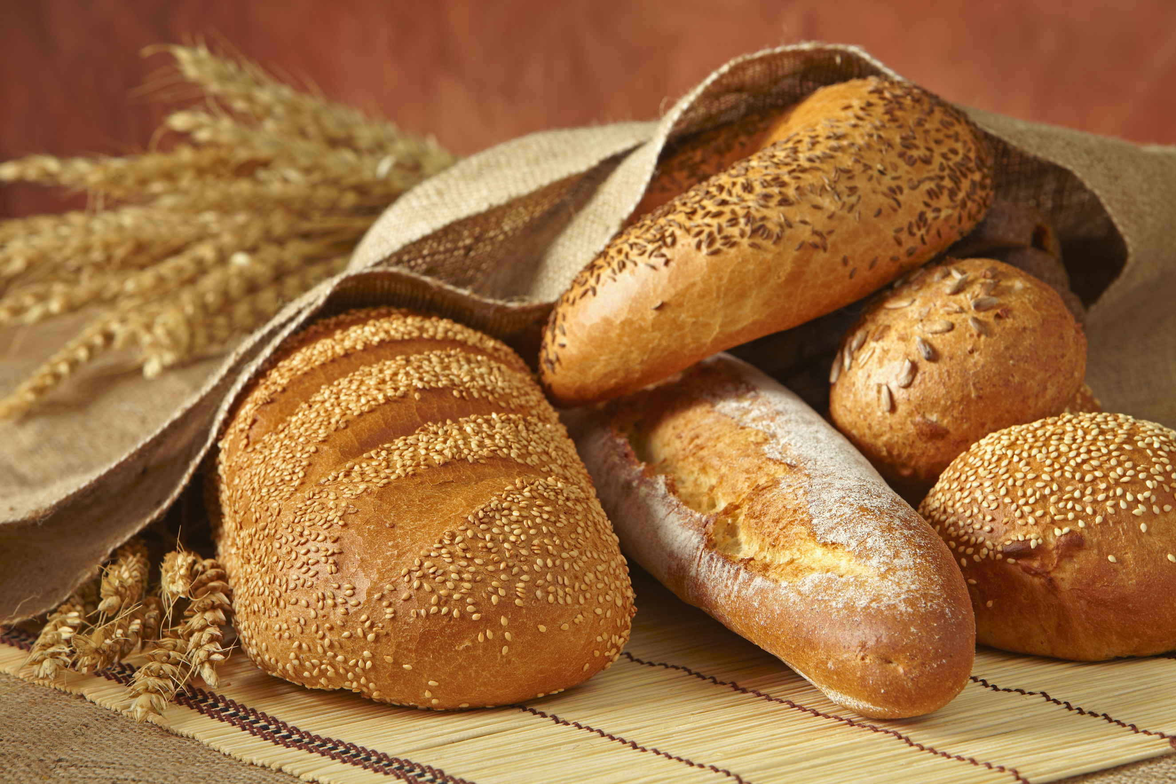

Slide 5
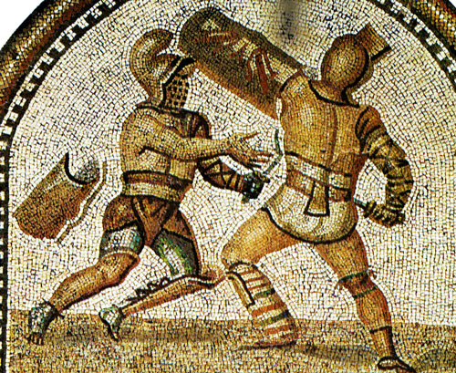

Slide 6
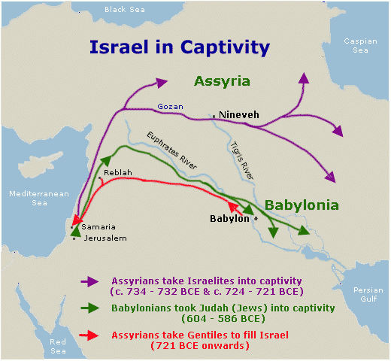

Slide 7
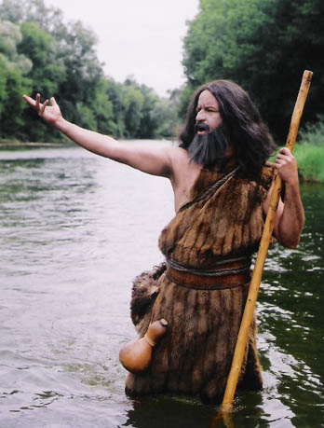

Slide 8
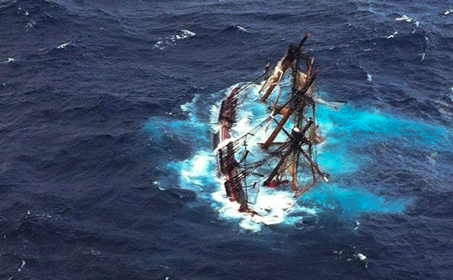

Slide 9
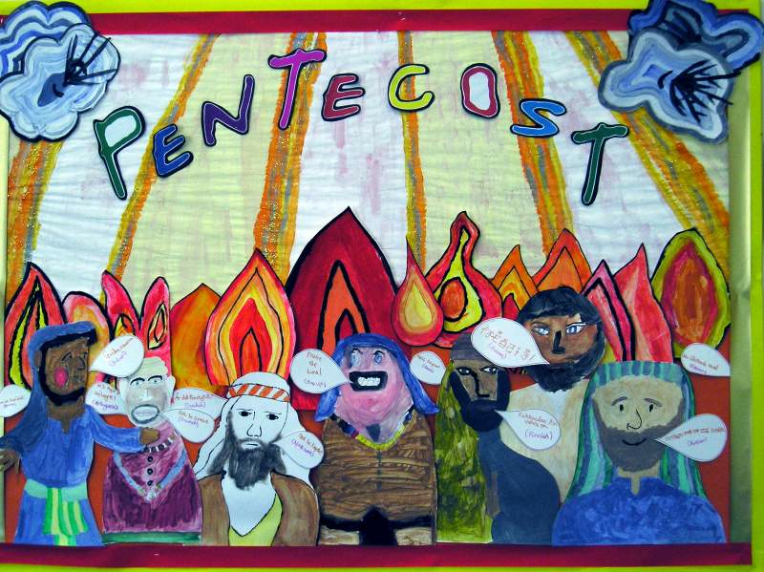

Slide 11
When we listen to many other voices,
But fail to wait for you to speak
Father we are sorry
When we think you have forgotten us
And that our problems are too big for you to help
Father we are sorry

Slide 12
When we try to solve things our own way, without relying on your strength
Father, we are sorry

Slide 13
We believe in God the Father,
from whom every family
in heaven and on earth is named.
We believe in God the Son,
who lives in our hearts through faith,
and fills us with his love.

Slide 14
We believe in God the Holy Spirit,
who strengthens us
with power from on high.
We believe in one God;
Father, Son and Holy Spirit.
Amen.

